Slide 1

GROUP MEMBER SUPERVISIOR Nitinkumar ANAGHAN Dr. Yohan FOUGEROLLE Akshaykumar DUDHAGARA Cansen JIANG Bhargav SHAH David STRUBEL Flavien DAVID
UNIVERSITY OF BOURGOGNE
SOFTWARE EANGINEERING
3D SCANNER

Slide 2
OVERVIEW
Objective
Software and Hardware
Architecture of 3D Scanner
Registration
Meshing

Slide 3
Objective
The Main Objective of this Project is to do 3D Scanning of full body using 3D reconstruction algorithm.

Slide 4
Software and Hardware
QT
PCL
MICROSOFT KINECT V2

Slide 5
Architecture of 3D Scanner
Point Cloud 1
Point Cloud 2
Registration
Filtering
Down sampling and Smoothing
Point Cloud n
Meshing
3D Model

Slide 6
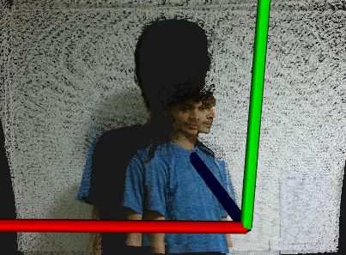
Registration
Notes:
THE REGISTRATION PROBLEM: In this process 3D data alignment is generally known as registration. In the registration two main methods are available: rigid and non-rigid is the mapping transformation can be modelled by using six degrees of freedom, the letters one consider the problem of softer bodies whose shape can change during data acquisition. Registration algorithms are independently a pair of point registration approaches.
FILTERING: After acquiring the 3D point clouds from Kinect, the next step is to later them to retain only the points of the scanned body, removing all unwanted points from background and the outliers of the body. For this purpose we use many later functions provided by the pcl letters library from PCL.
DOWNSAMPLING: The data acquired by kinect is huge, if we were to perform a simple operation on every point of a cloud, n being the number of points. We noticed from the first time we worked with PCL, that even simple operations take much time. The solution we are working with is downsampling. Downsampling is done via voxelization, which introduce many voxel grids. The cloud is divided in multiple cube-shaped regions with the desired resolution. Then, all points inside every voxel are processed so only one remains. The simplest way would be to randomly select one of them, but a more accurate approach would be to compute the centroid, which is the point whose coordinates are the mean values of all the points that belong to the voxel. If done with sensible parameters, downsampling will yield results that are precise enough to work with, at the cost of less CPU power.
SMOOTHING: As stated, depth sensors are not very accurate, and the resulting clouds have measurement errors, outliers, holes in surfaces, etc. Surfaces can be reconstructed by means of an algorithm, that iterates through all points and interpolates the data, trying to recreate the missing parts of the surface by higher order polynomial interpolations between the surrounding data points. PCL uses the Moving Least Squares algorithm. Performing this step is important, because the resulting cloud's normal's will be more accurate. The smoothing method takes 2 arguments, first one is the pointer to the input point cloud, and the second is the Search radius for which the algorithm will choose the neighbours to use in the algorithm. To address smoothing the surface, we apply moving least squares algorithm for surface reconstruction.

Slide 7
Registration
The registration problem
FILTERING
DOWNSAMPLING
SMOOTHING
Notes:
THE REGISTRATION PROBLEM: In this process 3D data alignment is generally known as registration. In the registration two main methods are available: rigid and non-rigid is the mapping transformation can be modelled by using six degrees of freedom, the letters one consider the problem of softer bodies whose shape can change during data acquisition. Registration algorithms are independently a pair of point registration approaches.

Slide 8
Filtering
Filtering is a technique for modifying or enhancing an image.
The main purpose of the filtering in 3D scanner project is to later them to retain only the points of the scanned body, removing all unwanted points from background and the outliers of the body.
Notes:
FILTERING: After acquiring the 3D point clouds from Kinect, the next step is to later them to retain only the points of the scanned body, removing all unwanted points from background and the outliers of the body. For this purpose we use many later functions provided by the pcl letters library from PCL.

Slide 9
DOWNSAMPLING
The data acquired by kinect is huge, if we were to perform a simple operation on every point of a cloud, n being the number of points. We noticed from the first time we worked with PCL, that even simple operations take much time. The solution we are working with is downsampling.
Notes:
DOWNSAMPLING: The data acquired by kinect is huge, if we were to perform a simple operation on every point of a cloud, n being the number of points. We noticed from the first time we worked with PCL, that even simple operations take much time. The solution we are working with is downsampling. Downsampling is done via voxelization, which introduce many voxel grids. The cloud is divided in multiple cube-shaped regions with the desired resolution. Then, all points inside every voxel are processed so only one remains. The simplest way would be to randomly select one of them, but a more accurate approach would be to compute the centroid, which is the point whose coordinates are the mean values of all the points that belong to the voxel. If done with sensible parameters, downsampling will yield results that are precise enough to work with, at the cost of less CPU power.

Slide 10
SMOOTHING
Smoothing is often used to reduce noise within an image or to produce a less pixelated image. PCL uses the Moving Least Squares algorithm. Performing this step is important, because the resulting cloud's normal's will be more accurate.
Notes:
SMOOTHING: As stated, depth sensors are not very accurate, and the resulting clouds have measurement errors, outliers, holes in surfaces, etc. Surfaces can be reconstructed by means of an algorithm, that iterates through all points and interpolates the data, trying to recreate the missing parts of the surface by higher order polynomial interpolations between the surrounding data points. PCL uses the Moving Least Squares algorithm. Performing this step is important, because the resulting cloud's normal's will be more accurate. The smoothing method takes 2 arguments, first one is the pointer to the input point cloud, and the second is the Search radius for which the algorithm will choose the neighbours to use in the algorithm. To address smoothing the surface, we apply moving least squares algorithm for surface reconstruction.

Slide 11
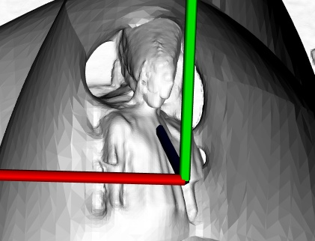
MESHING
COLLECTION OF VARIOUS POINTS
GREEDY PROJECTION TRINGULATION
POISSON
Notes:
Meshing : A point cloud represents a collection of various points set in dierent dimensions which are commonly used to represent 3 dimensional data. In point clouds the points refer to the X, Y and Z geometric coordinates of a surface. Here, for the project purpose, Point clouds are acquired by using Kinect v2 device. It is a Time of light laser scanner which measure the elapsed time between a light emission and sensor detection. There are four main steps to be considered when using the point cloud data to reconstruct a surface:
eliminate irrelevent data and sampled points to reduce the computational time
Find relation between data point
Start process of generating the surface using polygons and create meshes.
Edit model created to perfect the polygonal surface resulted.
Greedy projection: (GT) is to keep a list of possible points that can be connected to create a mesh. Greedy triangulation is obtained by adding short compatible edges between points of the cloud, where these edges cannot cross previously formed edges between other points. The focus of fast triangulation is to keep a list of possible point that can be connected to create a mesh.
Poisson: Poisson surface reconstruction combines both the local and global methods; however the RBFs(redial basis functions) functions are associated with the ambient space and not the data points. The Poisson reconstruction uses the Poisson equation, which is also known to be used in systems that perform tone mapping, uid mechanics and mesh editing.

Slide 12
THANK YOU

